Slide 1

Introduction to Zeek
NSF Cybersecurity Summit
Oct 27, 2026

Slide 2
Who Are We?
Christian Kreibich
Zeek Technical Lead and LT member
Engineer at Corelight
20+ years of network security, research, and engineering
Fatema Bannat Wala
Security Engineer @ ESnet/LBNL
11+ yrs of hands-on network defense
Zeek LT Member / Zeek Training Subgroup Lead

Slide 3
Agenda (9am - 12pm)
What is a Zeek / Cluster? - Fatema
Become familiar with Cluster Configs - Fatema
Zeek’s Filesystem Layout - Fatema
Running Zeek in a Cluster - Fatema
(break 10:30 am - 10:45 am)
Invoking Zeek via cmd line - Christian
Zeek log analysis - Christian
Zeek Package Manager - Christian
(Lunch 12:00 pm - 1 pm)

Slide 4
Housekeeping
Zeek’s Official Documentation: https://docs.zeek.org
Join Zeek Slack channel #training
Slide deck for this training can be found here: https://github.com/zeek/zeek-training/tree/master/Intro-to-Zeek/training-res/ZeekWorkshop26 Training.pptx
  Have a copy of slide deck open in a browser tab, for easy copy/paste of the commands in exercises!
  Shortened link: https://bit.ly/intro-zeek
Notes:
The links in the slide deck references to the Zeek Doc online, and the links are clickable.

Slide 5
Docker / Zeek Usage
Setup your Zeek Docker image
  Grab the latest Zeek LTS image from https://hub.docker.com/u/zeek
# docker pull zeek/zeek:lts
# docker run -it zeek/zeek:lts
  Inside the container, set up resources used during this training:
# git clone --depth 1 https://github.com/zeek/zeek-training
# ln -sfn /usr/local/zeek zeek
# ln -sfn /zeek-training/Intro-to-Zeek/training-res training-res
# cd zeek-training
# ./setup.sh intro-to-zeek
  To run additional shells in the container, use tmux or
# docker exec -it <container name> /bin/bash
Verify that Zeek runs correctly: # zeek --version
Notes:
If zeek is installed on your own server/laptop, you can pull down the training-repo and use the export command.

Slide 6



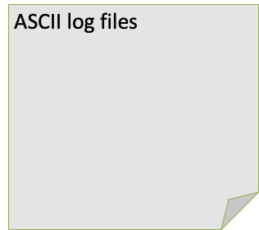

What is Zeek?
Zeek NSM
Sniffs traffic
Generates logs
http.log
ssl.log
ssh.log
smtp.log
weird.log
notice.log

Slide 7
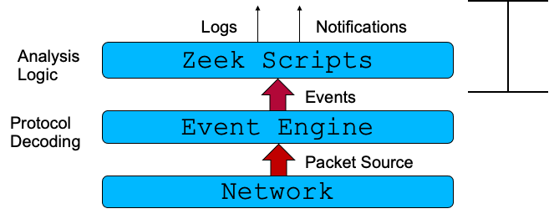

Zeek Packet Pipeline

Slide 8
What is a Zeek Cluster?

Slide 9
What / Why
A Zeek Cluster is a set of system processes, all running Zeek, with a set of scripts that adjust their purpose
  As opposed to running a single Zeek process, reading from a pcap, for instance
  Can run on one or more host environments — machines, VMs, containers, etc
To scale Zeek to keep up with more traffic, one adds processes (“nodes”) to the cluster
Supporting tools handle tasks like monitoring processes and log rotation
If you need 24x7 network monitoring, clustering is your answer

Slide 10
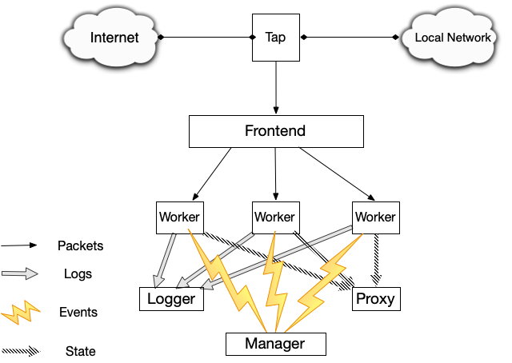
Source : Zeek Project. Creative Commons

Slide 11
Cluster Components
Manager
Worker
Proxy
Logger

Slide 12
Cluster Components
Manager
  Every cluster has exactly one
  Writing logs from workers (when not using separate logger nodes)
  Useful for smaller volumes or limited hardware
  Can also run scripts when you want to conduct analysis across multiple workers
  Natural point in the cluster for centralized state

Slide 13
Cluster Components
Manager
Worker
  Analyze network packets to create (most) events & logs
  Run scripts to alert on interesting traffic

Slide 14
Cluster Components
Manager
Worker
Proxy
  State sharing among cluster workers
  Start with one, then add more if load is an issue

Slide 15
Cluster Components
Manager
Worker
Proxy
Logger
  Write logs via configurable writer plugins for files, Kafka, Elastic, etc
  Easy support to load balancing among multiple logger nodes
    Log rates vary depending on traffic and writer technology
    Very roughly, up to 100K events/sec per logger should work
  Good way to scale log I/O in high volume environments
  Defaults to TSV-format file logging, but easy to switch to JSON or alternatives

Slide 16
Performance
LBL 100G Paper
  Good architecture overviews
SEPTun-Mark-II
  Originally written for Suricata, but all concepts on packet queues, NUMA, OS tuning, etc apply
CPU Pinning
  Avoid using hyperthreaded cores for workers
Fine tuning via ethtool - tro/tso/rx/tx/ etc..
Consider Shunting - Dumbno script (for Arista N/W LB)

Slide 17
Zeek’s Filesystem Layout

Slide 18
Filesystem Layout
Not an exhaustive tour!
Default top level path: /opt/zeek/ or /usr/local/zeek
  bin/
  etc/
  include/ - ignoring today
  lib/ lib64/ var/ - ignoring today
  logs/
  share/
  spool/

Slide 19
Filesystem Layout
bin/
  zeek-cut
    Extract columns from Zeek’s TSV logs (non-JSON)
    Convert Unix epoch
  zeek
    Zeek executable with various options to run
  zkg
    Zeek package manager executable
  zeekctl
    Cluster management tool

Slide 20
Filesystem Layout
etc/
  network.cfg
    Define your local networks
  node.cfg
    Configure a cluster
    Extra features (lb_procs, pin_cpu, lb_method)
  zeekctl.cfg
    Configure cluster management tool
    Set shorter rotation time

Slide 21
Filesystem Layout
logs/
  current
    Default Log Path (cluster-mode)
  current directory
    Default Log Path (CLI mode, logs overwritten
each run)
  YYYY-MM-DD
    Logs archived to this dir,rotated hourly by default

Slide 22
Filesystem Layout
spool/
  state.db
    Cluster worker state (zeekctl)
  zeekctl-config.sh
    Cluster management variables (zeekctl)
  worker-<n>
    .pid
    .cmdline
    .env_vars
  logger
    logs (“current” is a symlink)
  extract_files/<node>/
    Extracted (“carved”) files, when configured

Slide 23
Filesystem Layout
share/
  zeek/base/
    Base scripts
  zeek/policy/
    Additional scripts
  zeek/site/
    Site-specific scripts
    Packages installed via zkg, our package manager
  hilti/ and spicy/
    Analyzers written in Spicy, our parser generator
  zeekctl/
    Helper scripts for cluster management (e.g. log post-processing)

Slide 24
Exercise #1: fire up a cluster (10 mins)
Edit node.cfg - comment out the standalone section, and uncomment the logger, proxy, manager and worker-1 sections.
$ vi /zeek/etc/node.cfg
[worker-1]
type=worker
host=localhost
interface=af_packet::eth0
lb_method=custom
lb_procs=2
pin_cpus=0,1
Set shorter rotation time
$ vi /zeek/etc/zeekctl.cfg
LogRotationInterval = 300 //(5mins)
Set your local network
$ vi /zeek/etc/network.cfg

Slide 25
turn off the checksum with Zeek redef
$ vi /zeek/share/zeek/site/local.zeek
redef ignore_checksums = T;
Then run:
$ zeekctl deploy
Make sure cluster is running:
$ zeekctl status
Create some traffic for the cluster to sniff
$ wget -qO /dev/null https://google.com
$ ls /zeek/logs/current/
Send few pcaps to the sniffing interface:
$ tcpreplay -i eth0 --mbps=500 /training-res/traces/*.pcap
$ ls /zeek/logs/current/
Stop the cluster
$ zeekctl stop

Slide 26
MORNING BREAK [15 mins]
[10:30-10:45 am]

Slide 27
Invoking Zeek via the command line
For offline analysis use zeek -r on a packet capture:
# mkdir /scratch && cd /scratch
# zeek -r /training-res/traces/extract.pcap
# ls -l
Zeek doesn’t remove logs at startup, so run this to clean up:
# rm -f *.log
Zeek command to analyze live traffic:
# zeek -C -i eth0
listening on eth0
Generate some test traffic in another terminal
$ docker exec -it zeek-tutorial /bin/bash
# ping example.com -c 1
# exit
Notes:
Packet-fragments won’t work with @load...

Slide 28
Providing script values
Modify tunable variables directly from the command line
# zeek -r /training-res/traces/extract.pcap LogAscii::use_json=T
Change the HTTP analyzer to capture passwords. What difference do you notice in the log, with and without that addition?
# zeek -r /training-res/traces/http-basic-auth.pcap \
HTTP::default_capture_password=T
# cat http.log

Slide 29
Providing script values
Use zeek -e and provide arbitrary quoted Zeek script segments:
# zeek -e "print \"hello\"; print\"there\";"
hello
there
Read script code from standard input:
# echo "print \"Hello, world\!\";" | zeek
Hello, world!

Slide 30
Analyzing Zeek logs
Zeek’s default log format is tab-separated values, or TSV
# zeek -r /training-res/traces/extract.pcap
Using zeek-cut for more condensed log format
# cat conn.log | zeek-cut -m
Filtering on interesting fields
# cat conn.log | zeek-cut -m uid id.orig_h id.orig_p id.resp_h id.resp_p
Looking at the http.log file, notice the uid field
# cat http.log | zeek-cut -m uid host
convert the epoch timestamps to a human-readable format:
# cat conn.log | zeek-cut -m ts
# cat conn.log | zeek-cut -m -d ts

Slide 31
Zeek JSON logs
Zeek also allows emitting logs in JSON form, rather than as TSV files.
# zeek -r /training-res/traces/extract.pcap tuning/json-logs
# cat conn.log | jq
# jq -c '[."id.orig_h", ."id.resp_h"]' conn.log
You can do the same in a cluster by modifying your site’s local.zeek:
vim $PREFIX/share/zeek/site/local.zeek
Then add a line (anywhere!) that loads the policy/tuning/json-logs script:
@load policy/tuning/json-logs

Slide 32
Zeek logs IR example
Looking at some malicious traffic
# zeek -Cr /training-res/traces/2022-02-23-traffic-analysis-exercise.pcap local
Find suspicious connections
# cat conn.log | zeek-cut id.orig_h id.resp_h id.resp_p service conn_state | grep S0 | sort | uniq -c | sort -rn | head
Find outbound connections
# cat conn.log | zeek-cut id.orig_h id.resp_h id.resp_p service local_resp | grep F$ | sort | uniq -c | sort -rn | head -30
Once you find a suspicious IP, look at EVERYTHING about it
# SUSPECT="<suspicious-ip>"
# grep "$SUSPECT" *.log

Slide 33
Zeek’s package manager, zkg
Zeek comes with its own package ecosystem and package manager, zkg.
  Documentation
  https://packages.zeek.org
Packages can add functionality to Zeek at all levels
  Scripts add enrichments & detections. They modify or add logs.
  Plugins contain native code and build at install-time. They add packet sources, protocol parsers, log writers, and more.
Almost everything in Zeek is pluggable or extensible.

Slide 34
Example: the logschema package
Produces log schemas that detail your installation’s set of logs and their fields.
For each field, the schemas provide rich metadata including name, type, and docstrings.
They can also explain the source of a field, such as the specific script or the name of the Zeek package that added it.
Log schemas are also a great way to understand how and whether your logs change when you upgrade to a newer version of Zeek.

Slide 35
Example: the logschema package
To produce schemas, you need to tell Zeek which schema exporters to load.
# zkg install logschema
The following packages will be INSTALLED:
zeek/zeek/logschema (v2.0.0)
Proceed? [Y/n] y
Running unit tests for "zeek/zeek/logschema"
Installing "zeek/zeek/logschema"
Installed "zeek/zeek/logschema" (v2.0.0)
Loaded "zeek/zeek/logschema"

Slide 36
Exercise: JSON-Schema for your logs
Your local directory will now contain a JSON Schema description for each of your installation’s logs. If we want to find more about Zeek’s DNS log, we can do the following:
# zeek logschema/export/jsonschema
# cat zeek-dns-log.schema.json | jq

Slide 37
Exercise: zkg and the ja3 package
Let’s run Zeek with the JA3 package.
# zkg install ja3
# zeek -r /training-res/traces/extract.pcap ja3
# cat ssl.log
# cat ssl.log | zeek-cut -d ja3 ja3s

Slide 38
Some great packages
Detections: emudhra-weak-keys, php2shell-detect, redis-rce
Enrichments: add-interfaces, remote_asn_geoip_conn
Analyzers: CISA's ICS parsers, spicy-nats
Log writers: zeek-kafka, zeek-log-writer-nats
Miscellaneous: zeek-fuzzy-hashing, zeek-perf-support, zeek-xdp

Slide 39
Lunch Break

